Slide 1
Market Basket Analysis Report
Insights into Customer Purchasing Behavior
By
OFIABULU UJU EUCHARIA
JULY, 2024

Slide 2
Introduction
Market Basket Analysis:
Identifies patterns and relationships in customer purchasing behavior
Helps businesses understand customer preferences
Supports cross-selling, upselling, and product placement optimization.

Slide 3
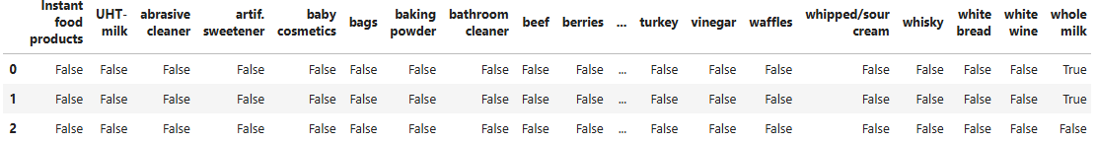
preprocessing
In summary, this code demonstrates the use of the TransactionEncoder to perform one-hot encoding on a dataset called transactions. The resulting encoded data is stored in a Pandas DataFrame, which can then be used for further analysis or as input to a machine learning model
te = TransactionEncoder()
te_ary = te.fit(transactions).transform(transactions)
df = pd.DataFrame(te_ary, columns=te.columns_)
df.head()
These code demonstrates the use of the TransactionEncoder to perform one-hot encoding on a dataset called transactions. The resulting encoded data is stored in a Pandas DataFrame, which can then be used for further analysis or as input to a machine learning model

Slide 4
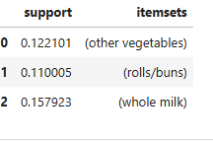
processing
# Generate frequent itemsets using the Apriori algorithmfrequent_itemsets = apriori(df, min_
support=0.1, use_colnames=True)frequent_itemsets
This code above and the Apriori algorithm are commonly used in association rule mining and market basket analysis to identify the most frequently purchased item combinations. The frequent itemsets can then be used to generate association rules, which can provide insights into customer behavior and help with product recommendations, cross-selling, and targeted marketing efforts.

Slide 5
Dataset Attributes
  antecedents: "If" part of the rule.
  consequents: "Then" part of the rule.
  antecedent support : Proportion of transactions with antecedent.
  consequent suppor t: Proportion of transactions with consequent.
  Support : Proportion of transactions with both items.
  Confidence : Likelihood of consequent given antecedent.
  Lift : Observed support vs. expected support.
  Leverage : Difference between observed and expected support.
  Conviction : Deviation from independence model.
  zhangs_metric : Composite measure of support and confidence.

Slide 6
Key Findings
Frequent Itemsets:
  Commonly purchased items: (whole milk), (rolls/buns), (yogurt).
Strong Associations:
  High support and confidence rules, e.g., (whole milk) => (rolls/buns).
Lift and Leverage:
  Lift around 0.8, suggesting less frequent co-purchases.
  Generally negative leverage values.
Conviction and Zhang's Metric:
  High conviction values indicate strong rule deviation from independence.

Slide 7
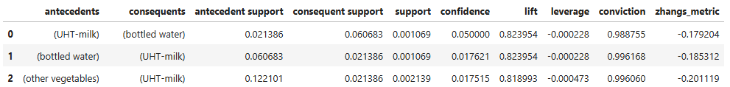
The key findings highlight the most frequently purchased items, the strong association rules between them, and the measures of interestingness (lift, leverage, conviction, Zhang's metric) that provide insights into the nature of the relationships between the items. These insights can be valuable for understanding customer purchasing behavior and identifying potential cross-selling opportunities.

Slide 8
Implications and Recommendations
Dataset Attributes : antecedents: "If" part of the rule.
consequents: "Then" part of the rule.
antecedent support: Proportion of transactions with antecedent.
consequent support: Proportion of transactions with consequent.
support: Proportion of transactions with both items.
confidence: Likelihood of consequent given antecedent.
lift: Observed support vs. expected support.
leverage: Difference between observed and expected support.
conviction: Deviation from independence model.
zhangs_metric: Composite measure of support and confidence
These attributes collectively provide a comprehensive understanding of the association rules and their characteristics. They help identify the most interesting and meaningful rules by considering the support, confidence, and various interestingness measures.

Slide 9
Exploring Outlier Rules
Unique Customer Behaviors : Positive leverage rules, e.g., (detergent) => (rolls/buns), (salty snack) => (canned beer).
Opportunities to explore unique customer behaviors and new strategies.
By analyzing and understanding positive leverage rules, businesses can uncover valuable insights about their customers' purchasing patterns, preferences, and behaviors. This knowledge can then be leveraged to develop more effective marketing strategies, enhance the customer experience, and explore new business opportunities.

Slide 10
Conclusion
Summary:
  Market basket analysis reveals valuable insights into customer purchasing patterns.
  Insights support optimization of product offerings, marketing strategies, and operations.
  Goal: Enhance customer satisfaction and drive sales and profitability.

Slide 11
THANK YOU

